Slide 1
MODULE 1
INTRODUCTION

Slide 2
SYSTEM
What is a System?
Way of doing one or more task(s) according to the fixed program/plan.
Example
Time display system – A watch
Automatic cloth washing system – A washing machine

Slide 3
What is an Embedded System?
“An embedded system is a system that has software embedded into computer-hardware, which makes a system dedicated for an application(s) or specific part of an application or product or part of a larger system.”

Slide 4
Embedded System - Definitions
An Embedded system is computing system other than a desktop computers- Frank Vahid/Tony
An embedded system is the one that has computer hardware with software embedded in it as one of its most important component.
It is any device that includes a programmable computer but is not itself intended to be a general purpose computer-Wayne Wolf

Slide 5
Embedded System are electronics systems that contain a Microprocessor, Micro Controller, but we don’t think of them as computer. The computer is hidden in the system- Todd D.Mortan
An embedded system is a System whose principle function is not computational, but which is controlled by computer embedded with in it. – Tim Wilmshurst

Slide 6
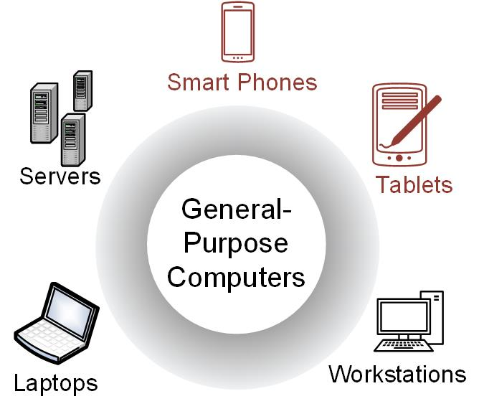
Introduction to Embedded Systems
General-Purpose Computers
Able to run a variety of software.
Contain relatively high-performance hardware components (fast processors, data & program storage).
Require an operating system (OS).
Image Courtesy of
Recording Connection of Canada
1.1 What is an Embedded System?

Slide 7

General-Purpose Computers
Designed for heavy user interaction.
Uses a variety of peripherals (displays, keyboards, mice, internet connections, wireless communication capability).
Expensive ($100s - $1000s).
Use a group of integrated circuits or chips (ICs).
One implements the central processing unit (CPU).
Several implement data memory and program storage.
Possesses a distributed architecture (full functionality of the computer is spread across multiple IC chips).
Image Courtesy of
Recording Connection of Canada
1.1 What is an Embedded System?

Slide 8
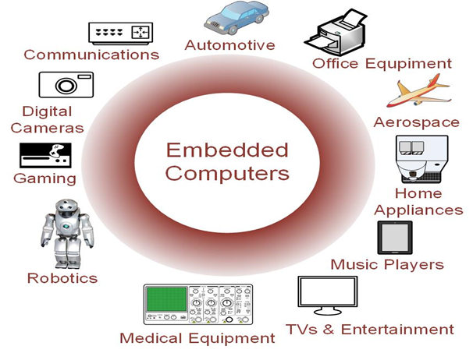
Embedded Computers
Resources can be implemented on a single IC.
Include a variety of peripherals (timers, analog-to-digital converters, digital-to-analog converters, serial interfaces).
Small size makes them very versatile.
Image Courtesy of
Recording Connection of Canada
1.1 What is an Embedded System?

Slide 9
Ch. 1: Introduction to Embedded Systems
Embedded Computers
Contains firmware (only the needed software which is not intended to be changed frequently).
May contain Real Time Operating Systems (RTOS) which are used as a task scheduler.
Low cost (10s of cents to a few dollars).
Image Courtesy of
Recording Connection of Canada
1.1 What is an Embedded System?

Slide 10
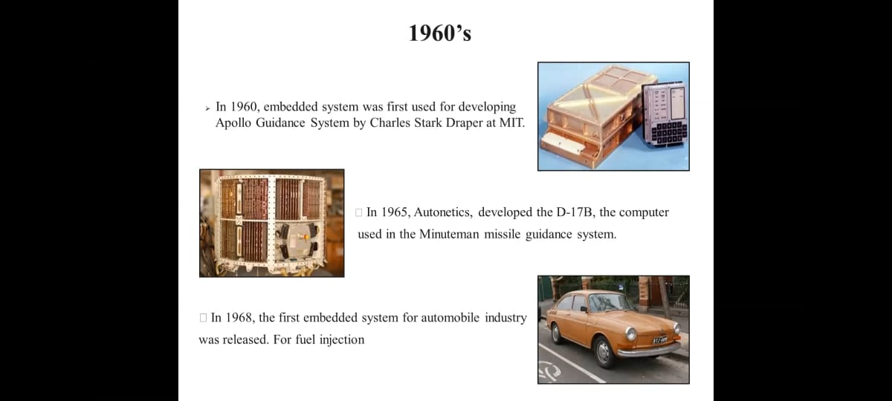
HISTORY OF ES

Slide 11
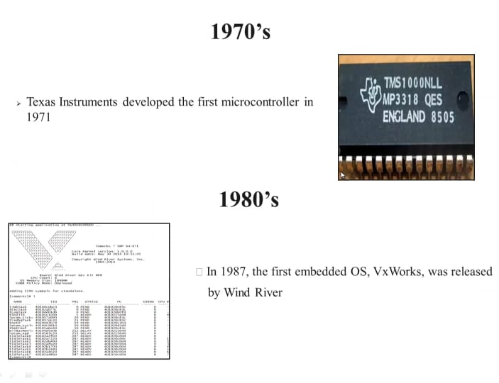

Slide 12
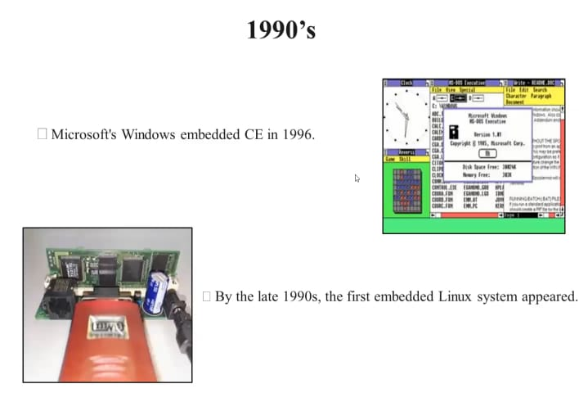

Slide 13
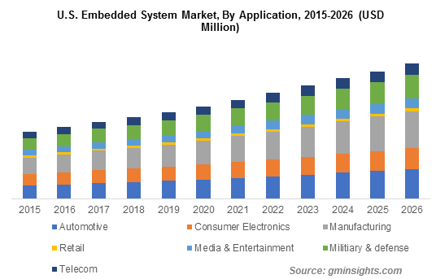
GROWTH OF ES

Slide 14
Microprocessor Vs Microcontroller
Microprocessor
Collection of on/off SWI on Silicon for computations
CPU is stand-alone, RAM, ROM, I/O, timer are separate
designer can decide on the amount of ROM, RAM and I/O ports.
Expandable
Expensive
High Speed (1000 MIPS)
General purpose and Versatile
Large Architecture (32b, 64b)
Lots of IO and Peripherals externally connected
Microcontroller
Small and self-suffice SoC to control devices
CPU, RAM, ROM, I/O and timer are all on a single chip
fix amount of on-chip ROM, RAM, I/O ports
Not Expandable – no external bus interface
for applications in which cost, power and space are critical
Low speed, on the order of 10 KHz – 20 MHz
single-purpose
Small usually an 8b
Limited IO, enough for intended app

Slide 15
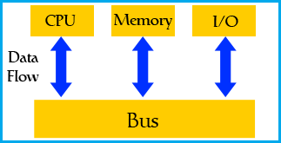
Microcontroller – Fundamental Components
Microcontroller incorporates onto the same microchip the following:
The CPU core
Memory (both ROM and RAM)
Some parallel digital I/O
Microcontrollers will also combine other devices such as:
A Timer module to allow the microcontroller to perform tasks for certain time periods.
A serial I/O port to allow data to flow between the microcontroller and other devices such as a PC or another microcontroller.
An ADC to allow the microcontroller to accept analogue input data for processing.

Slide 16
Automotive embedded systems
Today’s high-end automobile may have 100 microprocessors, but even inexpensive cars today use 40 microprocessors.
4-bit microcontroller checks seat belt;
microcontrollers run dashboard devices;
16/32-bit microprocessor controls engine.
Others control critical functions such as the ignition and braking systems.

Slide 17
Characteristics of Embedded System
Single Functional - cannot be programmed to do different things
pagers and mobile phones
Limited Resources - fixed RAM, ROM
No secondary storage CD-ROM, FDD
Work against deadlines - Real Time systems
Missing deadline cause catastrophe
Power constrained - Battery powered products
Highly reliable - No 3 finger salute – cannot afford to reset
Extreme environment conditions - Temperature and humidity
Cost sensitive to CE - Millions of units sold
Diversified processors and OS unlike desktop (intel + MS - Wintel)
complex to chose right platform

Slide 18
Challenges in Embedded Computing System Design:
How much hardware do we need ?
How to meet deadlines ?
How to minimize power consumption ?
How to upgrade ?
Does it really work ?
Is the specification correct?
Does the implementation meet the specification?
How do we test for real-time characteristics?
How do we test on real data?
How do we work on the system?
Observability, Controllability?
What is our development platform?

Slide 19
Challenges in Embedded Computing System Design
Hardware: (Memory, Microprcossor, Peripheral Device)
The power consumption, Performance deadline and manufacturing cost are based on hardware unit.
Minimizing hardware-fail to meet deadline
Maximizing hardware – too much expensive
Deadlines:
To speed up the hardware so that the program run faster.
that makes the system more expensive
Power consumption:
Battery powered and non battery powered applications
In non battery applications, excessive power consumption can increase heat dissipation.
Careful design is required to slow down the power consumption.
Design for upgradeability
Adding features for different applications

Slide 20
Reliability
Reliability is always important when selling products - customers rightly expect that products they buy will work.
Reliability is especially important in some applications, such as safety-critical systems
Security
Security is a key concern for modern embedded system design
Attacks on embedded systems can not only gain access to personal data but also cause the physical systems controlled by those embedded computers to perform dangerous acts.

Slide 21
Design methodologies
It is a procedure for designing a system.
A design methodology is important for three reasons.
First, It allows us to keep a scorecard on a design to ensure that we have done everything we need to do.
Second, It allows us to develop computer-aided design tools.
Third, A design methodology makes it much easier for members of a design team to communicate.

Slide 22
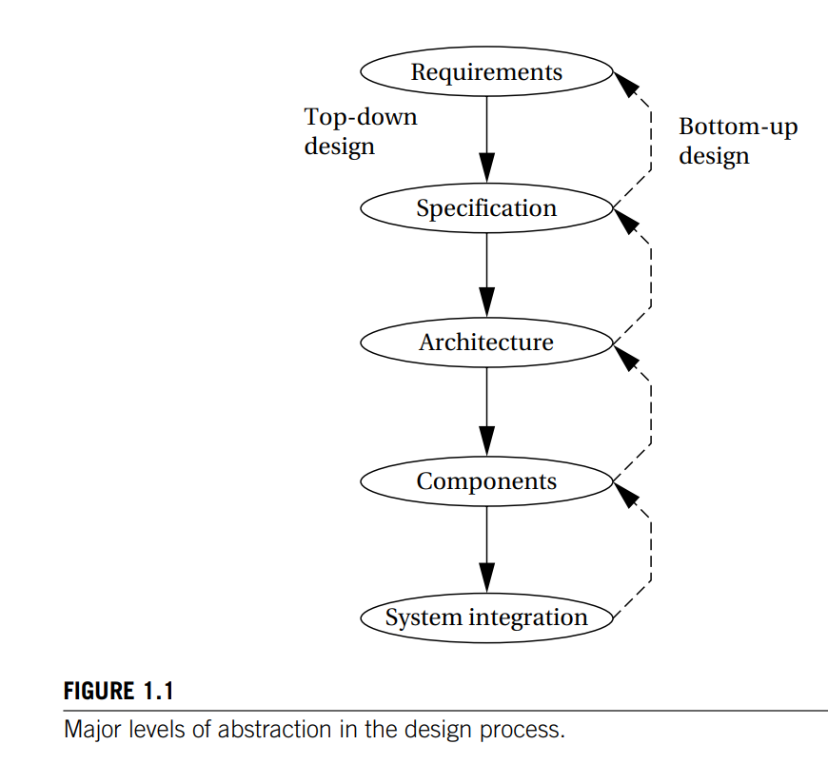
Embedded System Design Process
Top-down design:
we will begin with the most abstract description of the system and conclude with concrete details.
Bottom-up design:
we start with components to build a system.

Slide 23
Major Goals of the Design:
Manufacturing Cost.
Performance Speed.
Power Consumption.
At each Step in the design,
We must analyze the design at each step to determine how we can meet the specifications.
We must then refine the design to add detail.
And we must verify the design to ensure that it still meets all system goals, such as cost, speed, and so on.

Slide 24
Requirements
Plain language description of what the user wants and expects to get.
May be developed in several ways:
talking directly to customers.
talking to marketing representatives.
providing prototypes to users for comment.

Slide 25
Requirements
Functional requirements:
output as a function of input.
Non-functional requirements:
Performance - time required to compute output
Cost
Size, Weight, etc.
Power consumption
Reliability
etc.

Slide 26
Requirement Form

Slide 27
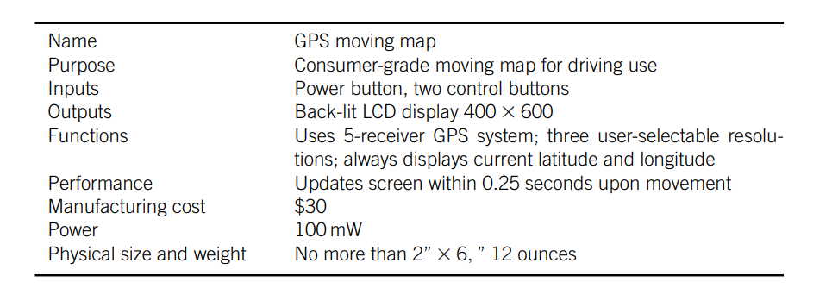
GPS REQUIREMENT FORM

Slide 28
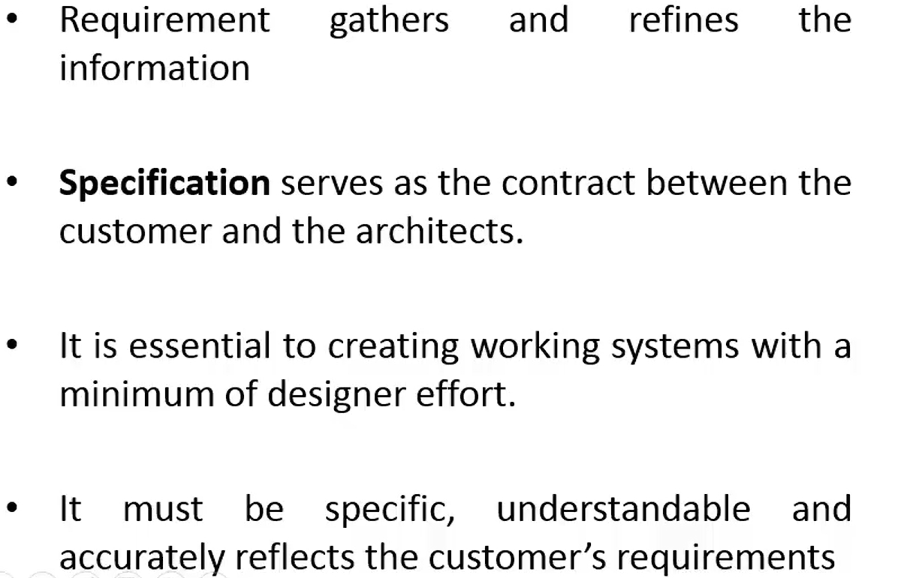
Specification

Slide 29
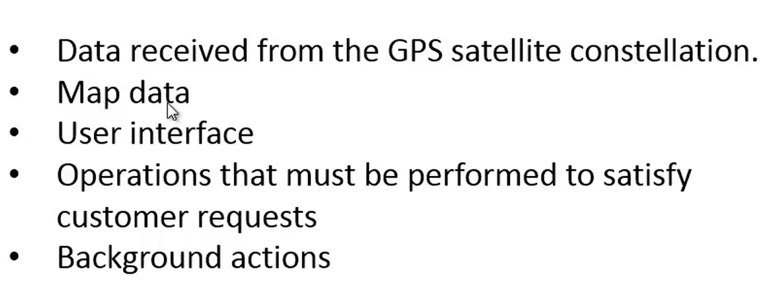
Specification

Slide 30
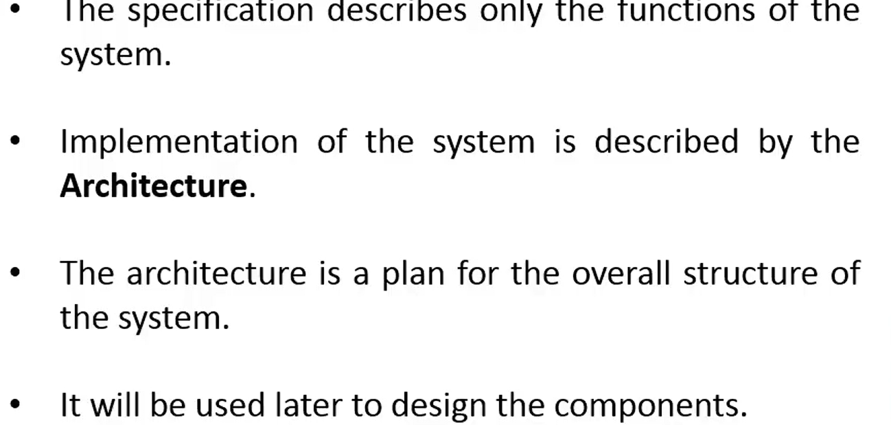
Architecture

Slide 31
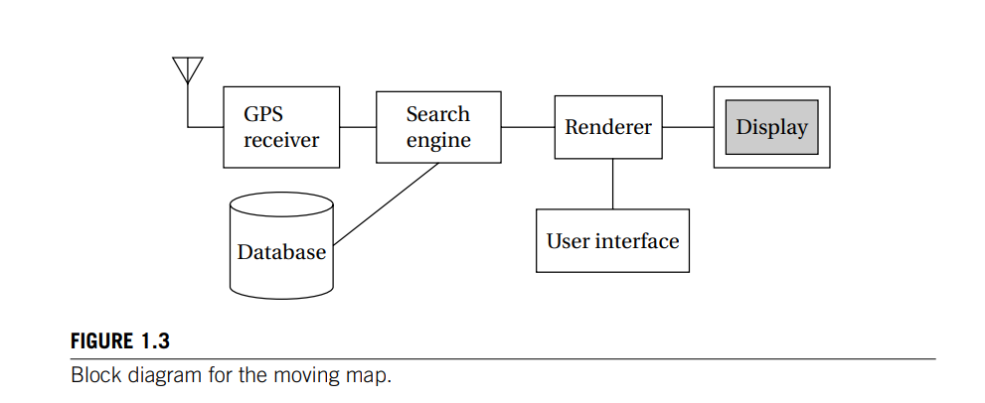
ARCHITECTURE DESIGN

Slide 32
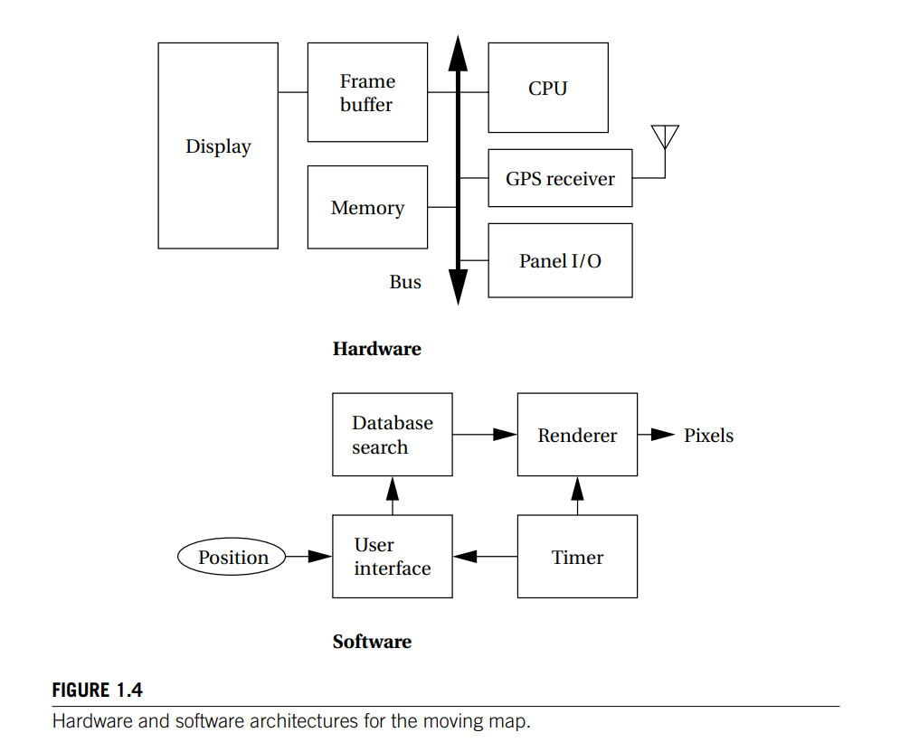

Slide 33
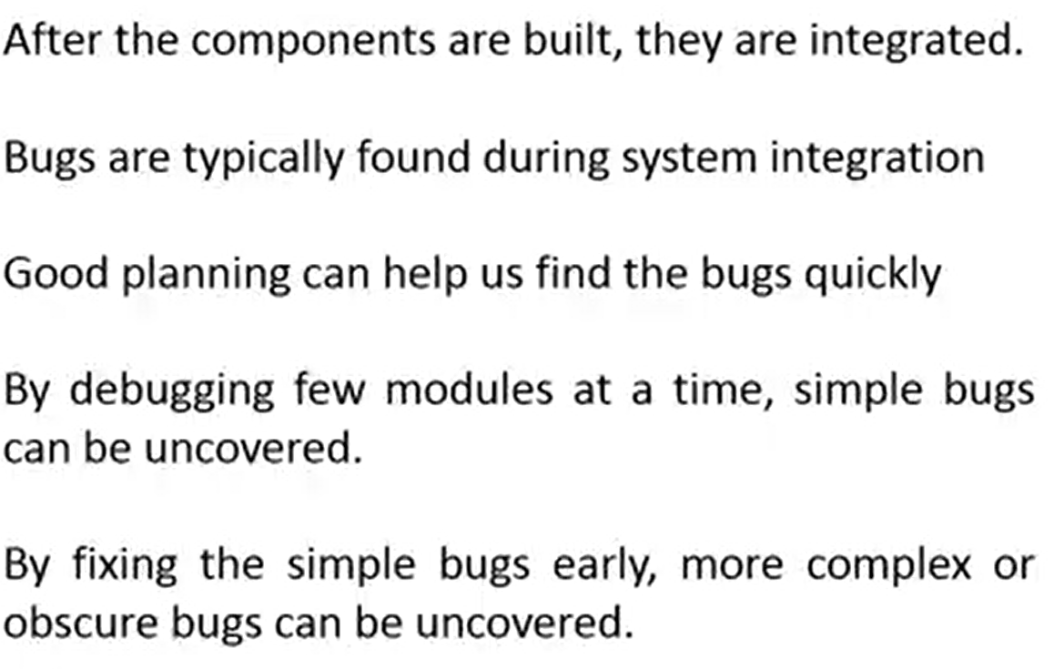
System integration

Slide 34
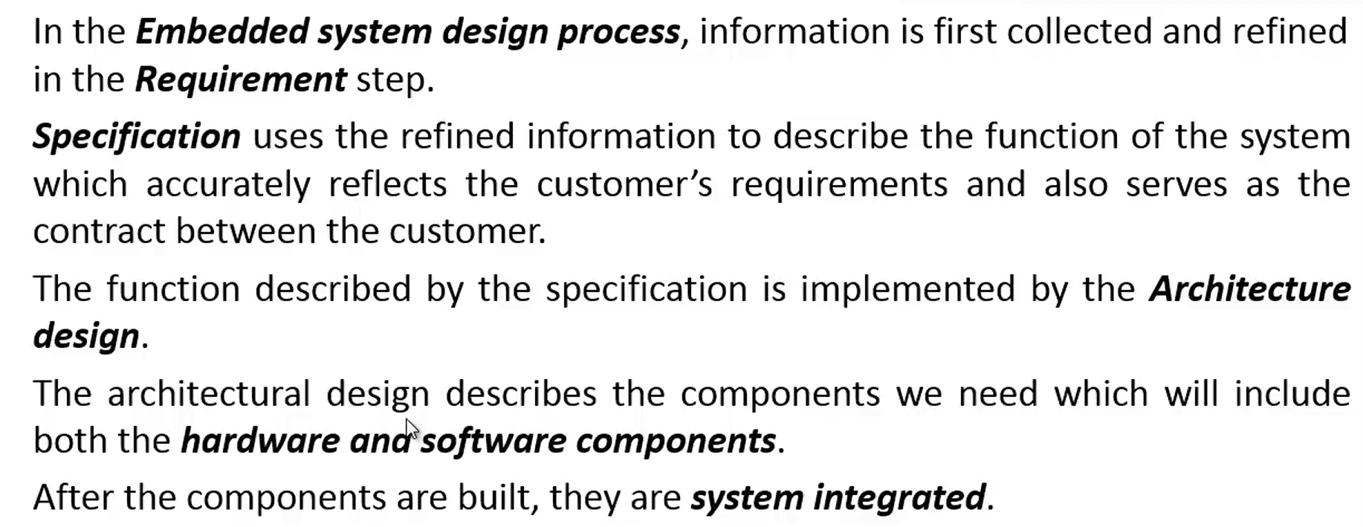
Overview

Slide 35
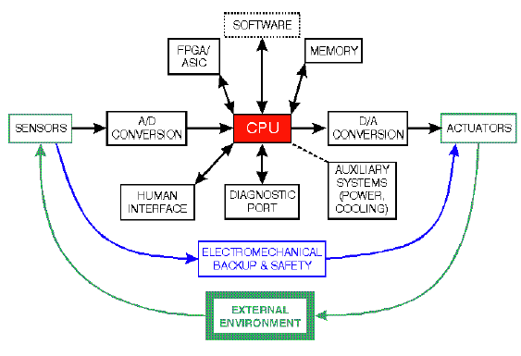
Embedded system architecture

Slide 36
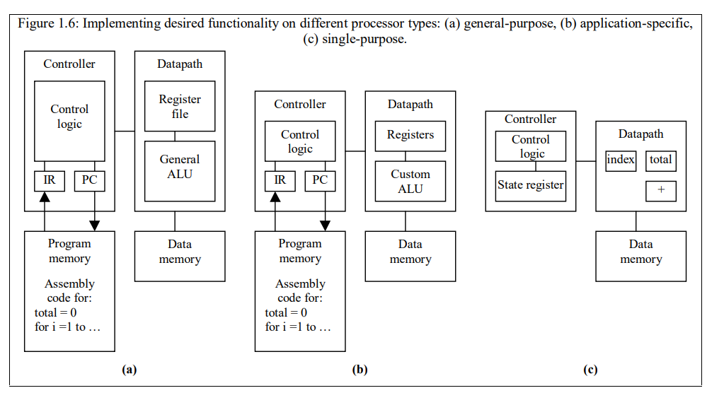
EMBEDDED PROCESSOR TECHNOLOGY

